Slide 1
MVC 5
(Model-View-Controller)
Deployment
Notes:
Prije početka pitati za iskustva koja polaznici imaju oko MVC 4.

Slide 2
Komponente web deploymenta
IIS Settings
  Application Pool
  Authentication metoda
  Error Handling
Skripte za deploy baze podataka
Postavke za produkciju/test
  Release / Debugging
  Connection Strings
Moguće su prilagođena proširenja
  Security Certificates
  Windows Registry postavke
  Sklopovi (Assemblies) za Global Assembly Cache (GAC)
Notes:
The information in this topic solely relates to Web Application Projects (WAP), and is all about what goes into a package and how to include it.
Question: In which scenarios have you used web deployment packages? What were the advantages? What were the disadvantages?
Answer: Will vary.

Slide 3
One-Click Publish
Udaljeni Deploy direktno iz alatne trake Visual Studia
Kreira Publish profile sa specificiranim postavkama
  Različiti serveri, iste postavke
  Isti serveri, različite postavke
  Različiti serveri, različiite postavke
Kompatibilan sa hostingom trećih strana
  Zahtjeva dodatne informacije od hosting providera
Notes:
One-Click Publishing is the simple and connected way of deploying a Web application, unlike Web Deploy packages, which can be sent to the administrator of the destination server for deployment at an appropriate time.
Question: In which scenarios have you used One-Click publishing? What were the advantages? What were the disadvantages?
Answer: Will vary.

Slide 4
Enterprise scenario
Udaljeni pristup do udaljenog servera
Developer
Computer
Test
Server
Publish
Developer
Computer
Test
Server
Package
Developer
Computer
Source Control
Test
Server
Package
Production
Server
Test
Server
Staging
Server
Production
Server
Package
Package
Production
Server
Notes:
Ensure the students how about different scenarios for which to deploy Web applications.
Question: How many intermediate environments have you seen in an enterprise scenario? Did you ever encounter a scenario where no intermediate environments were used?
Answer: Will vary.

Slide 5
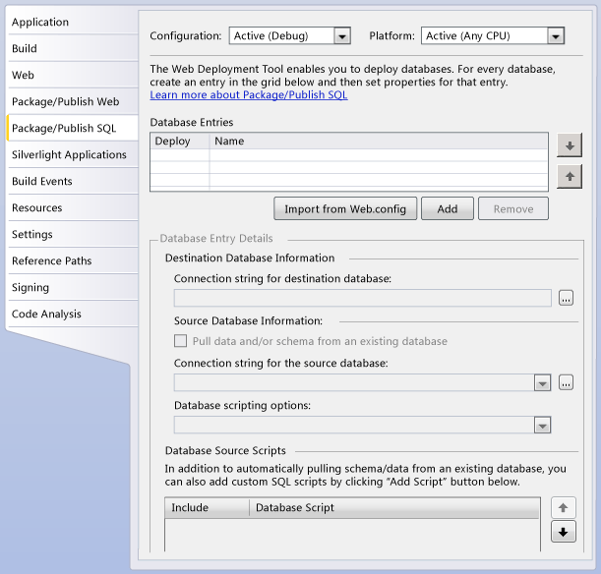
Deploy SQL Server baze podataka
Notes:
Make sure the students know how simple it is to use the Package/Publish SQL page of the Project Designer to get all database information packages.
Question: How do you currently propagate data structures and data? What are the advantages? What are the disadvantages?
Answer: Will vary

Slide 6
Pregled opcija deploymenta
Copy Web Site Tool
Publish Web Site Utility
Web.config File Deployment

Slide 7
Copy Web Site Tool
Sličan kao FTP alati
Podržava sinkronizaciju
Posebno koristan kada nije moguće uređivati datoteke na serveru
Mogući statusi datoteka su:
  Unchanged
  Changed
  New
  Deleted
Notes:
Question: Where have you leveraged the Copy Web Site tool?
Answer: Will vary
Question: What are some advantages to not having to recompile an application?
Answer: Faster, less chance of a component not functioning properly.

Slide 8
Publish Web Site Utility
Prekompajlira stranice, tj. izvorni kod unutar App_Code direktorija, i druge source datoteke u izvršne datoteke
  Izvlači izvorni kod iz datoteka
  Stvara kompajlirane sklopove
Prebacuje izvršne datoteke u odredišni direktorij.
Notes:
Question: Where have you leveraged the Publish Web Site utility?
Answer: Will vary.
Question: What are some advantages to having to recompile the application?
Answer: Ensures that all code is up to date and any compile errors are found.

Slide 9
Deployment Web.config datoteke
Inače je potrebno urediti Web.config datoteku na ciljanom serveru kod svakog deploymenta.
U tu svrhu bi bilo potrebno čuvati različite verzije Web.config datoteke za svaku serversku okolinu (u odvojenim direktorijima, sa brižno odabranim imenima datoteka), te kopirati jedino verziju koja je odgovarajuća za odredišni server.
Visual Studio može to napraviti za nas, uz pomoć odgovarajuće XSLT datoteke za transformaciju Web.config datoteke tijekom deploymenta.
Uobičajeni transform file
<?xml version="1.0"?>
<configuration xmlns:xdt="http://schemas.microsoft.com/XML-Document-Transform">
<connectionStrings>
<add name="ApplicationServices"
connectionString="[ProductionDatabase]"
xdt:Transform="Replace" xdt:Locator="Match(name)"/>
</connectionStrings>
</configuration>
Notes:
Question: Where have you leveraged the Publish Web Site utility?
Answer: Will vary.

Slide 10
Metode kompajliranja web aplikacije
Automatsko kompajliranje
  Aplikacija se kompajlira prvi put kada korisnik zatraži resurs sa web aplikacije ili site-a.
    Kreira se jedan sklop (assembly) za svaki direktorij, uključujući korijenski direktorij.
    Ako postoje datoteke koje sadrže kod više od jednog programskog jezika, imati ćemo jedan sklop (assembly) za svaki direktorij i za svaki jezik dodatno.
  Kako bi izbjegli dugo čekanje na odziv kod prvog pristupa, aplikacija može biti prekompajlirana.
Dinamičko kompajliranje
  Nakon prvog kompajliranja, datoteke su spremljene (cached) u memoriju.
  Bilo koja promjena kodiranih datoteka će biti okidač za rekompajlirannje.
  Kompajlirane datoteke su smještene na lokaciji: %SystemRoot%\Microsoft.NET\Framework\versionNumber\Temporary ASP.NET Files
Notes:
Describe the following:
Automatic compilation http://msdn.microsoft.com/en-us/library/ms178466.aspx
Dynamic compilation http://msdn.microsoft.com/en-us/library/ms366723.aspx

